Slide 1

Otoscope output image analysis
Capstone Project Phase B
Software Engineering (Course 61999)
Karmiel – Jan 2023
Author
Shlomi Levi 305129652
Supervisor
Mrs. Natali Levi

Slide 2

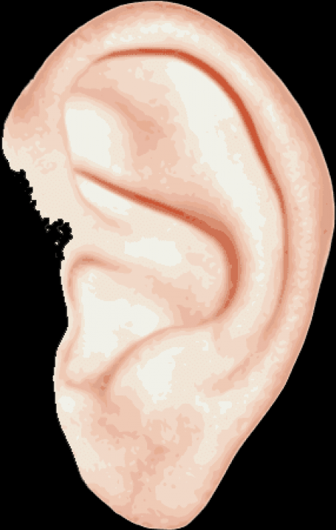
Introduction
Human health project
Infections of the middle ear
Detection, classification, and prediction of ear infection
Notes:
* In this project, I have chosen to meet a very primary need related to human health.
* Acute infections of the middle ear are among the most commonly treated childhood diseases
* My software will process an image using a device connected to a mobile device, similar to the operation of an otoscope, and analyze whether a person suffers from an ear infection

Slide 3
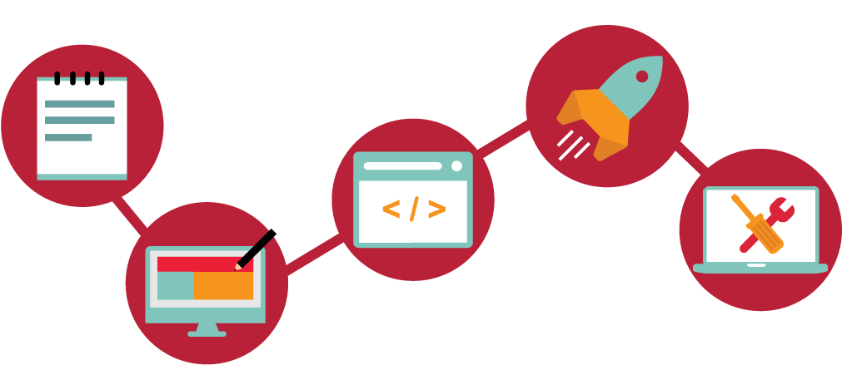
Proposed method
Easy-to-use application for infections prediction
External device that is connected to an android device
Notes:
* Development of an easy-to-use application capable of identifying and classifying data from an existing dataset using the ResNet-101 model
* I have an external device that is connected to an android supporting device used as an otoscope for photography

Slide 4
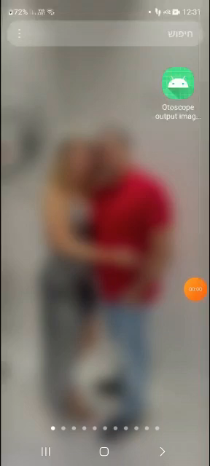
The application at runtime

Slide 5

Work process
My work is divided into two main parts:
Research process
1. A comprehensive theoretical understanding of the need
2. Learning about ear infections at a very deep level
3. Face the challenges
Notes:
2. know the tools available in the market and how they work.
3. Understanding the challenges that I will face and taking them into count in future development.

Slide 6

Development process
In-depth learning of the ways to identify inflammation
Creating the ideal model for the current input
Implantation of the model in the application
Notes:
1.In-depth learning of the ways to identify inflammation. familiarity with concepts and models from the world of machine learning
2. Preparing the application while creating the ideal model for the current input.
3. Implantation of the model in the application and finishing it.

Slide 7

Pre-processing
224x224 pixel 24bit images
Dataset calibration
Notes:
1. The default input for the models ResNet-101, ResNet-50, and Vgg-16 is
2. I had to adjust the size of the images to the input of the models, and make sure I had the same number of images in each class in the train and the test.

Slide 8
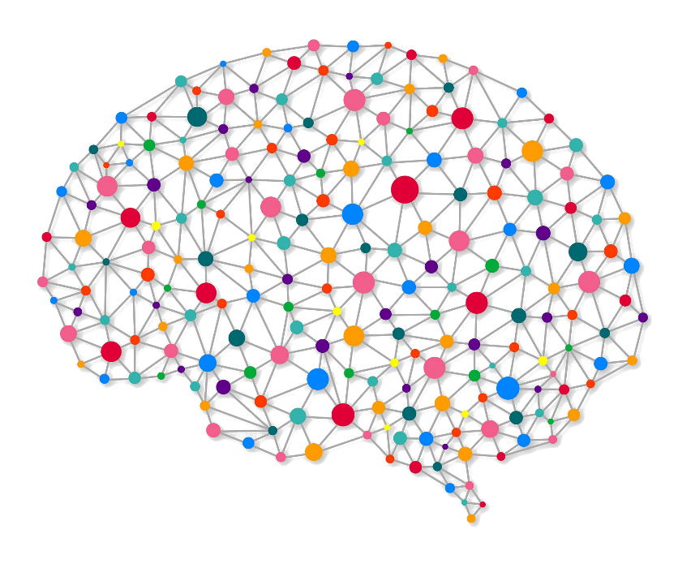
Neural Networks
Machine Learning
Deep learning
Transfer learning
Notes:
Artificial Neural Networks (or simply Neural Networks) are frameworks for different machine learning algorithms to work together and process data inputs.
2. Machine learning is an application of artificial intelligence (AI) that provides systems the ability to automatically learn and improve from experience without being explicitly programmed.
3 To train the model on my input I used the transfer learning technique which is very common in the deep learning field.
4. Transfer learning is a technique that focuses on storing knowledge gained while training one model and applying it to another model.
Deep learning is a branch of machine learning that imitates the work of the human brain in processing data and creating patterns for use in decision-making.

Slide 9
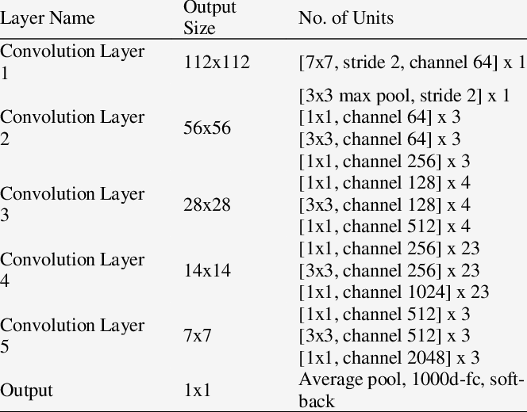
ResNet-101 Specification

Slide 10
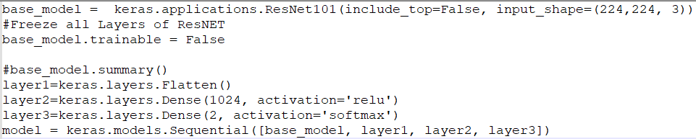
Model layers
Our model layers based on ResNet-101

Slide 11
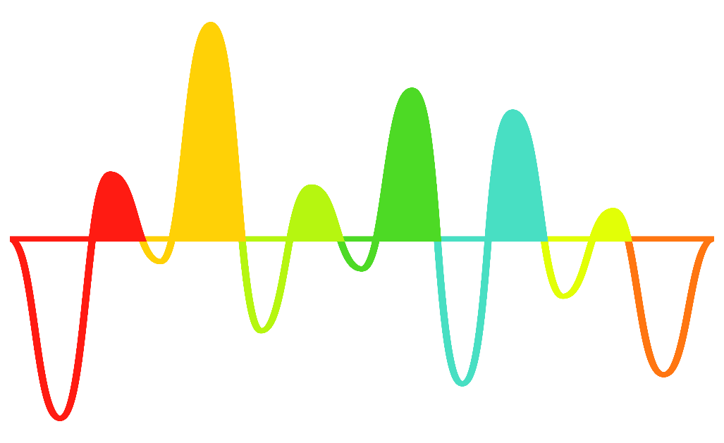
Hyperparameters adjustment
Optimizer
Epochs
Batch images
Notes:
To achieve the best results I had to examine and tune training parameters used by the learning algorithm that affect the model’s training such as:

Slide 12
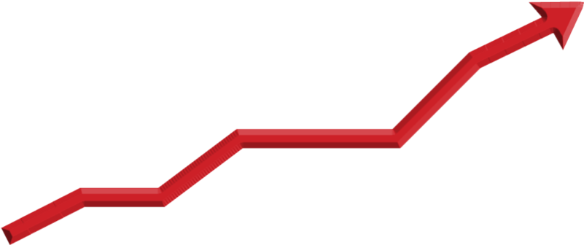
Model fit
Overfitting
Underfitting
Notes:
A good model fit is when the machine learning model achieves a balance between bias and variance and finds an optimal spot between the underfitting and overfitting stages.
Overfitting: Good performance on the training data, poor generalization to other data.
Underfitting: Poor performance on the training data and poor generalization to other data.
We aimed for Good performance on the training data and other data balance fitting.

Slide 13

Improving Model Accuracy
Freezing layers
Outlier detection
Collecting relevant data
Dropout
Notes:
Freezing layers prevents the model’s weights from being modified.
Outlier detection is nothing but data points or observations that fall outside of an expected distribution or pattern.
Collect data to Increase the number of training examples.
“Dropout” refers to the practice of disregarding certain nodes in a layer at random during training. A dropout is a regularization approach that prevents overfitting by ensuring that no units are codependent with one another

Slide 14
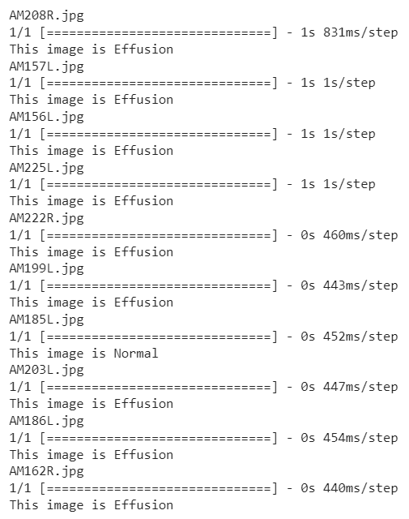
Results
10 Effusion test images were tested
9/10 of the data was observed correctly

Slide 15
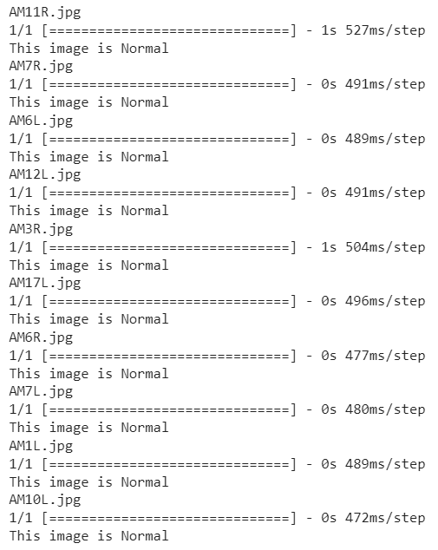
10 Normal test images were tested
10/10 of the data was observed correctly

Slide 16
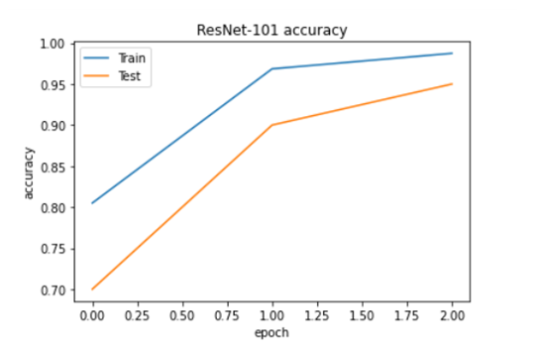
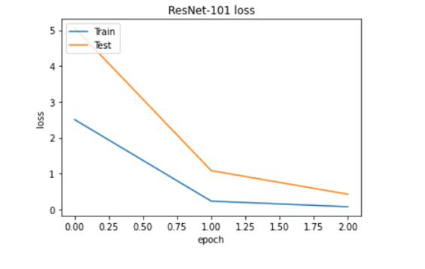
Accuracy and loss

Slide 17
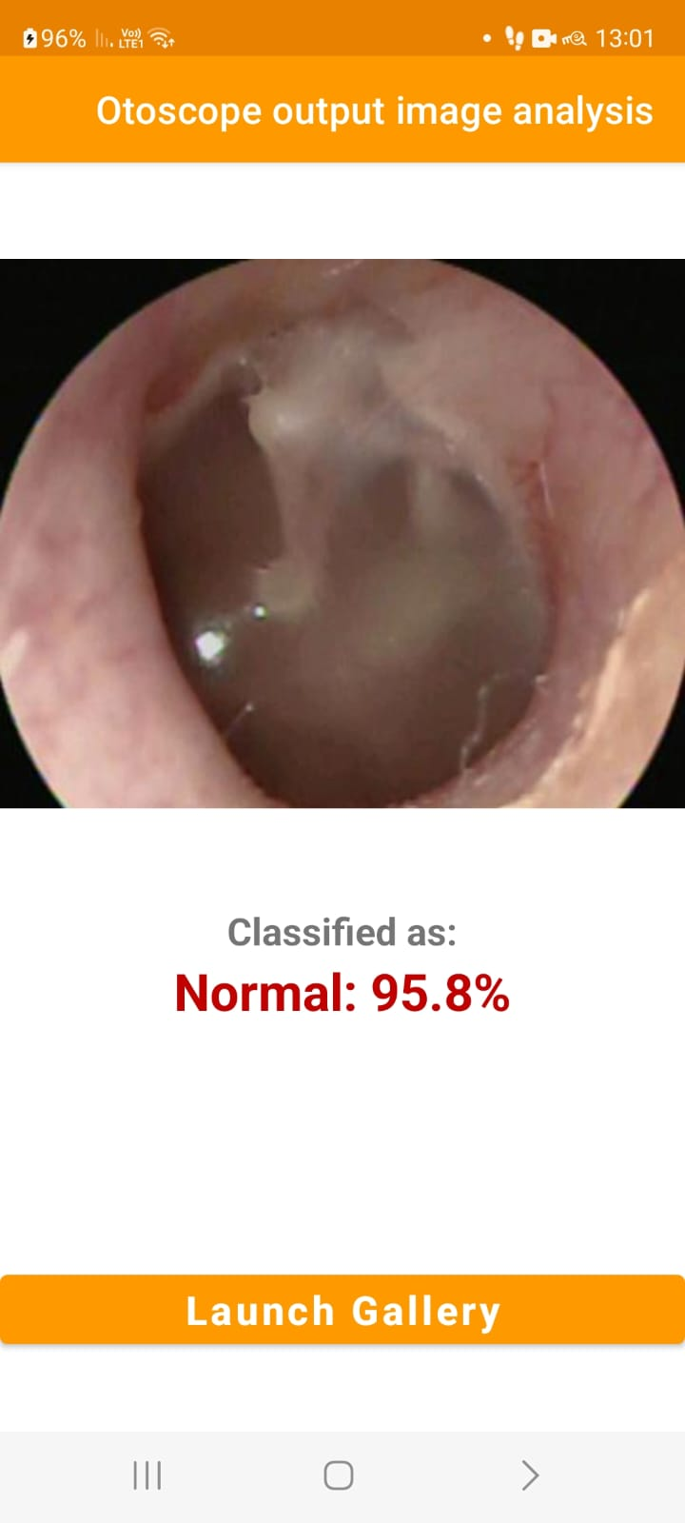
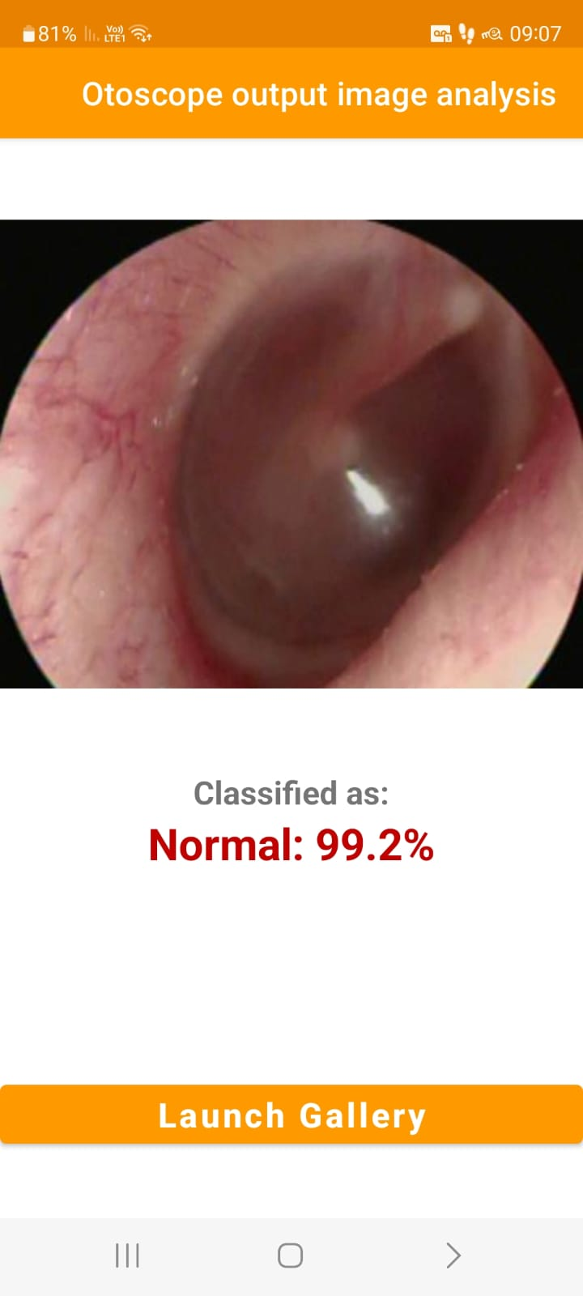
Normal predictions

Slide 18
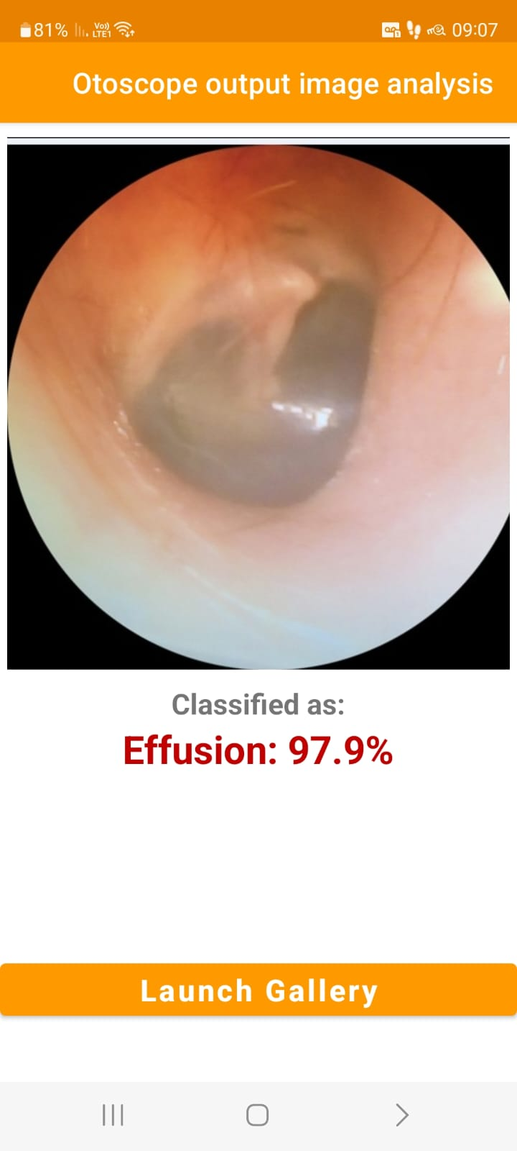
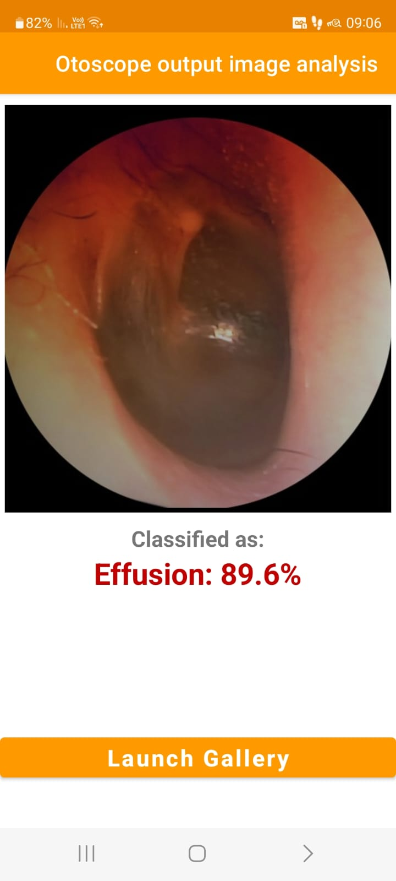
Effusion predictions

Slide 19

Conclusions
Notes:
In this project, I showed how transfer learning can be used in the context of otoscopy imaging retrieval. I used deep learning-based approaches to extract the features to compare the similarity of query images with training images. I explored the performance variability depending on some experimental design factors. In contrast, I observed that the performance would depend on the type of abnormality. Limitations of the study include a relatively small number of images in each category.
This project will be successful if the app will provide a 20% return on investment and 500 new customers within the first year of its operation

